Slide 1

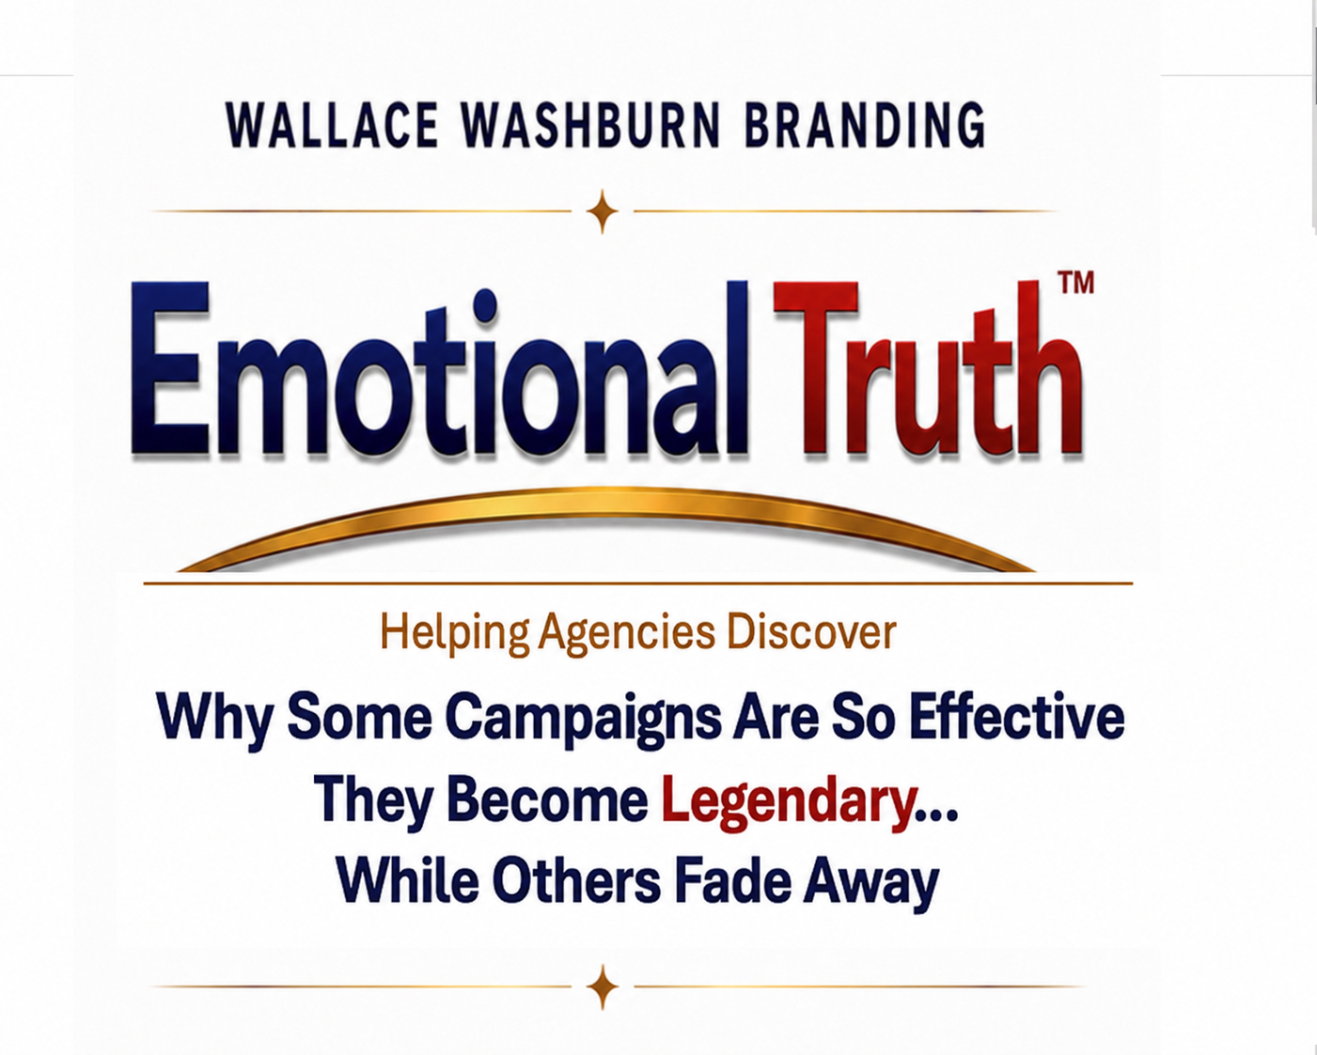


Slide 2
THE QUESTION I’VE SPENT MY CAREER TRYING TO ANSWER
For more than 30 years, I've been searching for the answer to one question...
“Why do some campaigns work so well they become legendary…while others fade away?”
Here’s the story of how I finally uncovered the answer.
Kim Wallace • Wallace Washburn Branding
Notes:
That question has bothered me for years. I think I finally know the answer.

Slide 3
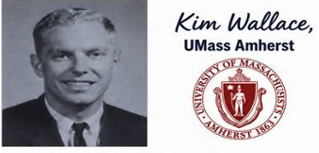
My first advertising campaign wasn't for Nike or Volkswagen. I was running for class President.
The race was tight, and I needed a favorable, memorable way to introduce myself to students who had never met me.
So, the night before the election I got a message posted at eye level on every bathroom stall on campus.

Slide 4
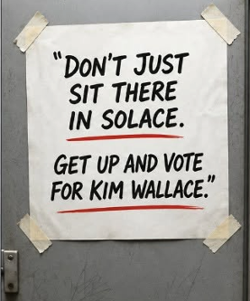
It worked…
I won by 36 votes.
What a great experience.
Maybe there’s a future for me in advertising.

Slide 5
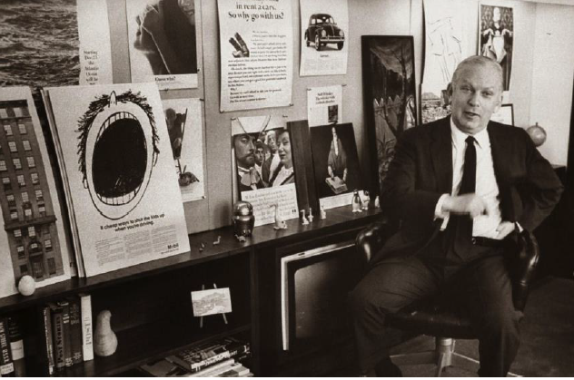
Bill Bernbach: Founder Doyle Dane Bernbach
Five years later I left a lucrative job as Exxon’s top salesperson in New England and took a low paying trainee job at Doyle Dane Bernbach advertising.
It was one of the best decisions I ever made.

Slide 6

Over the next 30 years I helped build brands, solved branding challenges and studied hundreds of winning campaigns.

Slide 7
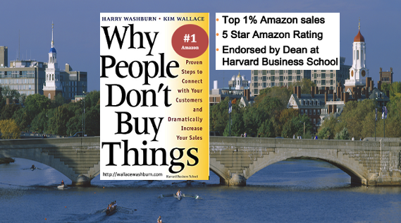
I found out Why People Don’t Buy Things.
Notes:
But writing the book actually left me with an even bigger question.

Slide 8
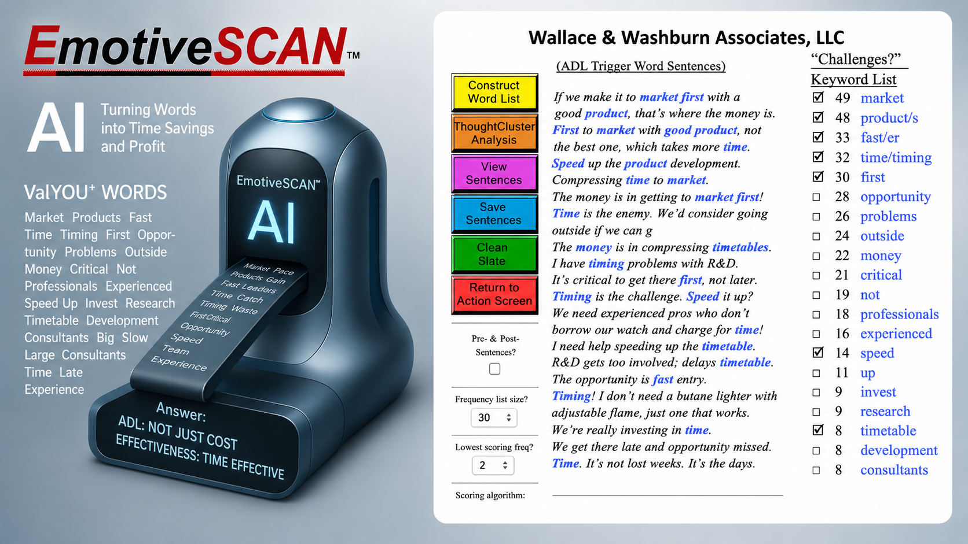
I even built EmotiveSCAN™, an advertising algorithm originally developed with a Harvard software engineer and continually enhanced over the years — most recently with AI. This enabled me to reverse-analyze more than 100 winning brands in unprecedented depth.

Slide 9
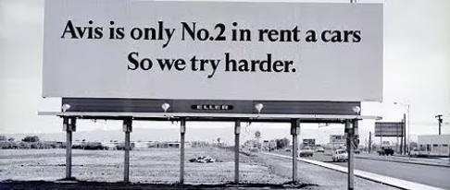
Yet one question kept nagging at me...
Why are some campaigns so effective
they become legendary …while others fade away?
Then I remembered something Bill Bernbach said while I was
working on the Avis account at Doyle Dane Bernbach:
"The most powerful element in advertising is the truth."
Notes:
The most powerful element in advertising is the truth. But what kind of truth?
Bernbach’s Story: Avis CEOs Wife

Slide 10

Snickers’ Truth: “You’re not you when you’re hungry.”
But what kind of truth?
Finally, after years of research and testing, “Dawn broke over Marblehead.”
Great campaigns don’t invent the truth. They begin with a brand’s most powerful truth – its Emotional Truth™.
Notes:
Great campaigns don’t invent the truth. They find it.

Slide 11

An Emotional Truth™ expresses the unfiltered reality of what people feel. Hidden within their spontaneous words, it reveals a genuine belief they may never have consciously recognized.
It may reflect a feeling people value about the brand— as in “The Few. The Proud. The Marines.”—or in an emotionally meaningful attitude or observation associated with it, such as Spaulding Rehab’s “The Power of Hope.”
An Emotional Truth™ becomes even more believable when connected to an Accepted Premise™.
Notes:
HW’s Quote Define AP “It’s easier to convince…”

Slide 12
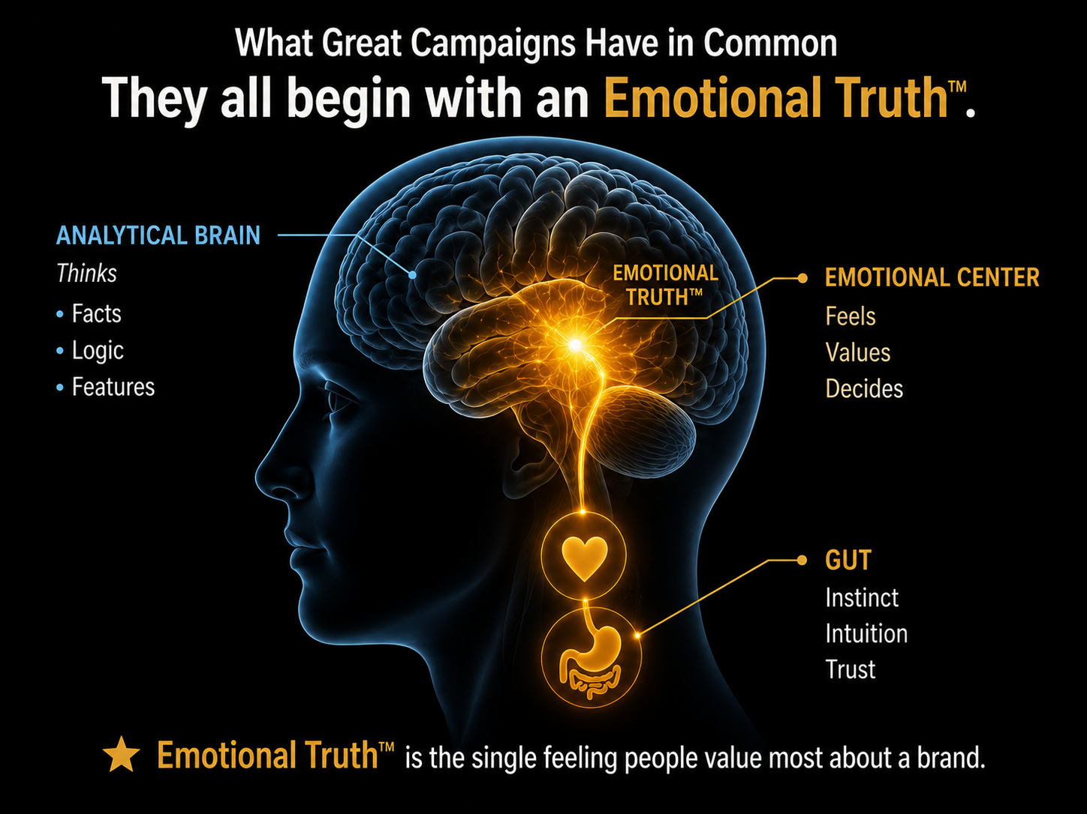

Notes:
Emotional Truth™— it’s what the legendary brands have.

Slide 13
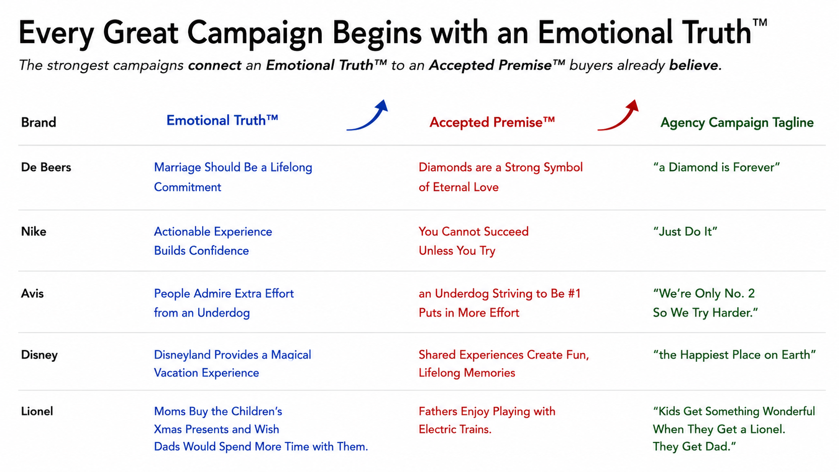
Notes:
Rev Eng 100 revealed same pattern: ET – AP – Agency Campaign Tagline. Notice the Flow. Every effective campaign starts with an Emotional Truth. That ET becomes believable because it Connects to an AP buyers already hold. Then agency creates memorable tagline.. :30 Nike didn’t invent confidence. They recognized that people gain confidence by taking action. They connected an ET to an AP we all believe expressed brilliantly with Just Do It. :45 Avis I actually worked on Avis at DDB. We accepted reality because people admire an underdog who tries harder. Once that AP clicked, We’re Only NO. 2. So we try harder almost wrote itself.

Slide 14
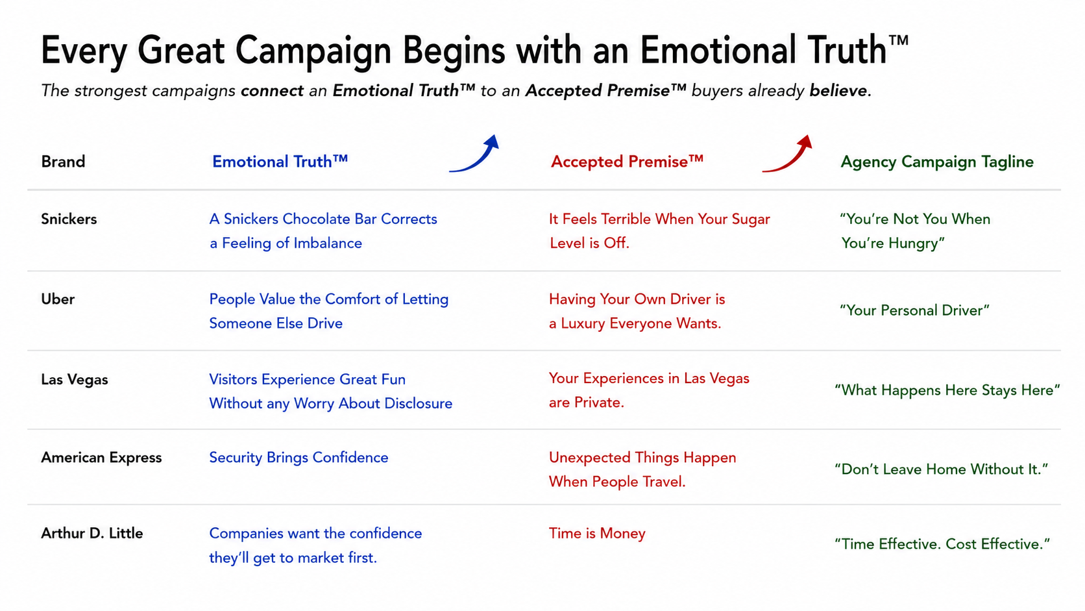
Notes:
What’s remarkable is that the same brand pattern shows up whether it’s a consumer brand of a B2B company. :60 Lionel I was fortunate to work on the Lionel team. Explain research MOM-Kids-Dad and Fathers Enjoy playing with electric trains. That became “Kids Get….the get dad.” It Helped save Lionel from bankruptcy. THE SAME PATTERN APPEARS AGAIN AND AGAIN. :60 ADL …Reputation for. Large, expensive and slow. Research revealed getting to market first was client goal. Positioned ADL Lean experienced teams and expressed it with Time Effective. Cost Effective. Landed 6 new accounts. In first 6 months. Hired us. Elsewhere. I won’t go through every example, but show this isn’t an isolated coincidence The same structure keeps appearing.

Slide 15
I first applied elements of this approach at Arnold (HBM), creating the “Accepted Premise” philosophy which helped win 6 new accounts in the first year.
Arnold’s legendary Accepted Premise campaign saved Lionel from bankruptcy. “Kids get something wonderful when they get a Lionel. They get dad.”
Today: Combining Emotional Truth™ with an Accepted Premise™ creates an even bigger opportunity.
Imagine opening a new-business conversation by saying:
“Our recent analysis of more than 100 winning, legendary brands revealed a powerful insight: The most successful campaigns connect with an Emotional Truth™—a powerful feeling customers value most, and your current advertising doesn’t appear to be tapping into it.”
A Possible Next Step
Notes:
Every legendary campaign begins with a stronger strategic foundation than most..
That's what Emotional Truth™ Discovery is designed to uncover.

Slide 16
Possible Next Steps:
Put Emotional Truth™ to Work for You in Three Ways
Discover Your Agency’s Emotional Truth™
Find the strongest Emotional Truth™ for your agency’s positioning, new-business story and growth.
2. Find an Emotional Truth™ to Help Win a New Account
Identify an Emotional Truth™ opportunity that could give your agency a powerful strategic advantage in a live pitch.
Strengthen a Current Client
Find the Emotional Truth™ opportunity that could sharpen the client’s positioning, strategy or creative direction.
Notes:
And here’s where this can become a business opportunity for you.

Slide 17
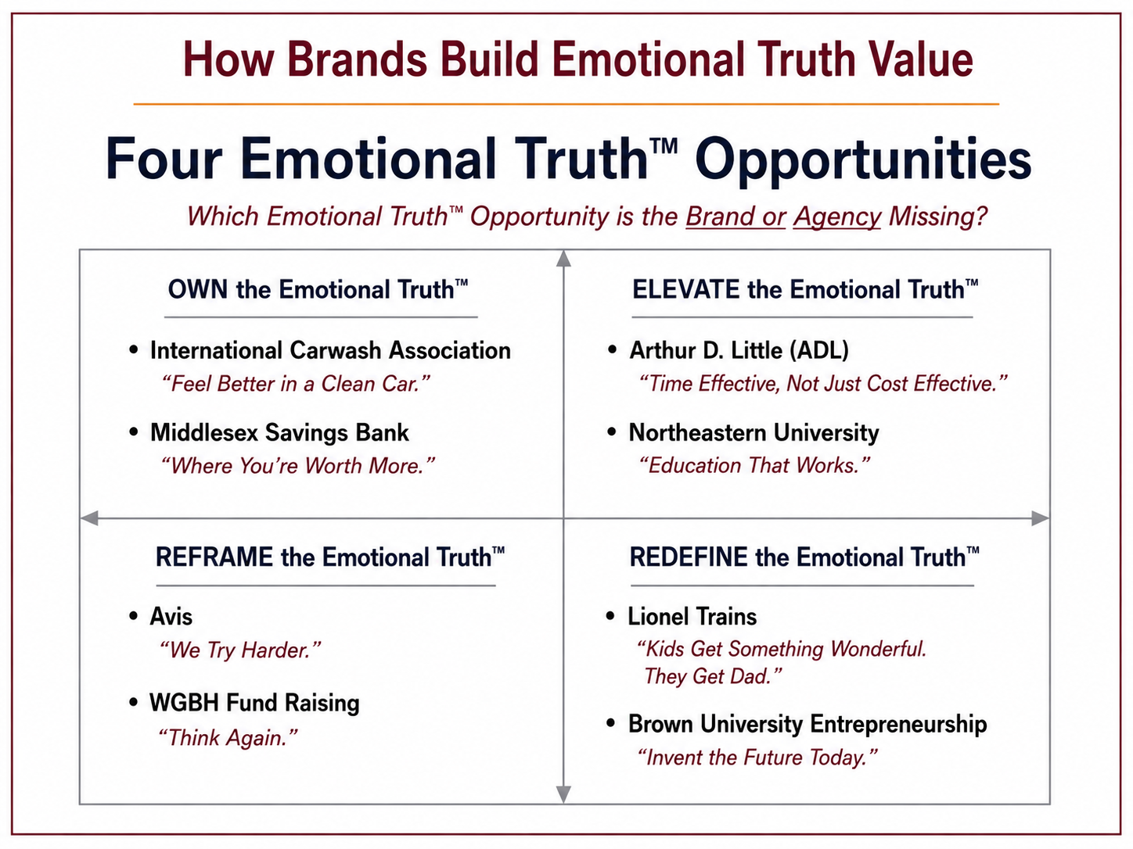
Notes:
No process can guarantee a legendary campaign. But every legendary campaign begins with a stronger strategic foundation than most.,
That's what Emotional Truth™ Discovery is designed to uncover.

Slide 18
Next Step: Put Emotional Truth™ to Work for Your Agency
Phase 1 — Emotional Truth™ Opportunity Scan
* 15 carefully selected interviews
* Industry/category research
* Competitive advertising/positioning analysis (3 brands)
* EmotiveSCAN™ analysis
* Identification of 2–3 possible Emotional Truth™ opportunities
* Kim’s recommendation of the strongest opportunity
Notes:
And here’s where this can become a business opportunity for you.

Slide 19
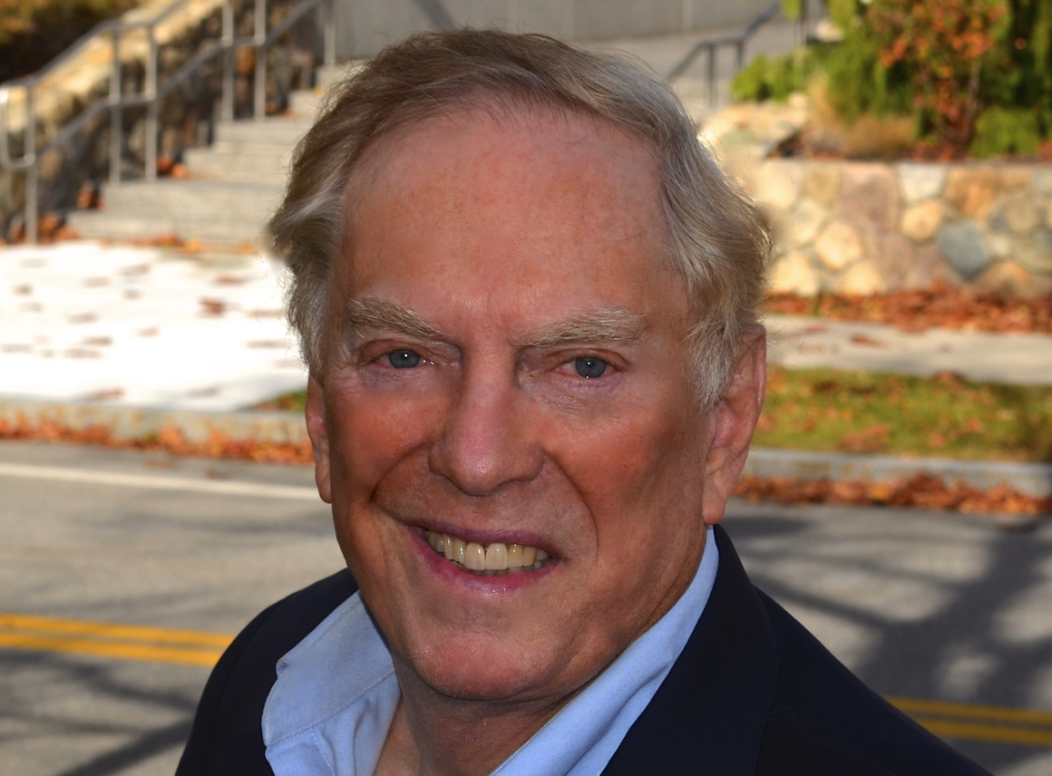
Phase 2 — Validate the Emotional Truth™ Opportunity
If the client is intrigued by the Emotional Truth™ opportunity, Wallace Washburn works with the agency to design a comprehensive research program to validate and develop it.
CLIENT INVESTMENT
Scope and cost depend on the assignment.
Kim Wallace
For details, contact kim@wallacewashburn.com
Or call (339) 970-8773
Notes:
And here’s where this can become a business opportunity for you.

