Slide 1

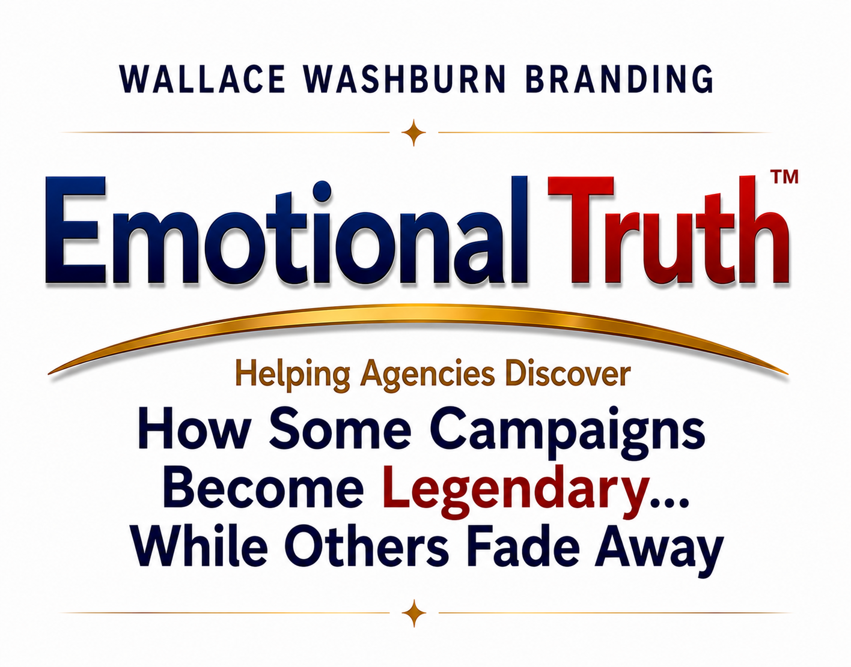


Slide 2
The Question That Changed Everything
For more than 30 years, I've been searching for the answer to one question...
“Why do some campaigns become legendary...while others fade away ?”
Here’s the story that led me to the answer.
Kim Wallace • Wallace Washburn Branding

Slide 3
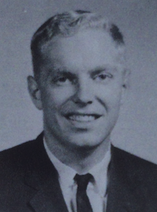
Kim Wallace for President UMass Amherst
My first advertising campaign wasn't for Nike or Volkswagen. I was running for class President.
The race was tight, and I needed a memorable way to introduce myself to students who had never met me.
So, the night before the election I got a message posted at eye level on every bathroom stall on campus.

Slide 4

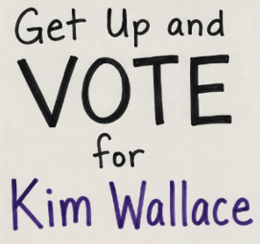
It worked…
I won by 36 votes.
What a great experience.
Maybe there’s a future for me in advertising.

Slide 5
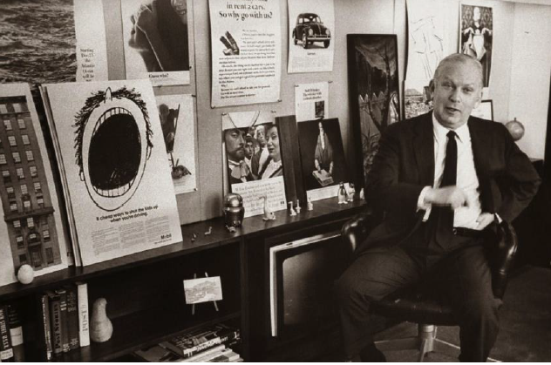
Bill Bernbach: Founder Doyle Dane Bernbach
Five years later I left a lucrative job as Exxon’s #1 salesperson in New England and took a low paying trainee job at Doyle Dane Bernbach advertising.
It was the best decision I ever made.

Slide 6

Over the next 30 years I helped build brands, solved branding challenges and studied hundreds of winning campaigns.

Slide 7
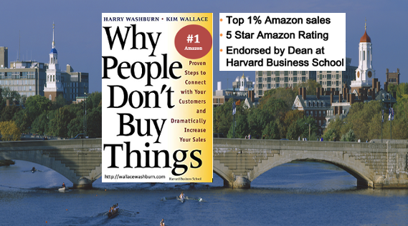
I found out Why People Don’t Buy Things.

Slide 8

I even built EmotiveSCAN™, an advertising algorithm originally developed with a Harvard software engineer and continually enhanced over the years — most recently with AI. This enabled me to reverse-analyze more than 100 winning brands in unprecedented depth.
Notes:
Developed by RA in Harry’s jazz band.

Slide 9
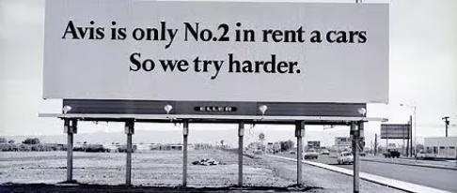
Yet one question kept bothering me...
Why do some campaigns become legendary…
while others fade away?
Then I remembered something Bill Bernbach said while I was working on the Avis account at Doyle Dane Bernbach: "The most powerful element in advertising is the truth."

Slide 10

Snickers’ Truth: “You’re not you when you’re hungry.”
So how do I find the truth? Finally, the answer became clear.
Great campaigns don’t invent the truth. They begin with the brand’s most powerful truth –
its Emotional Truth™.

Slide 11
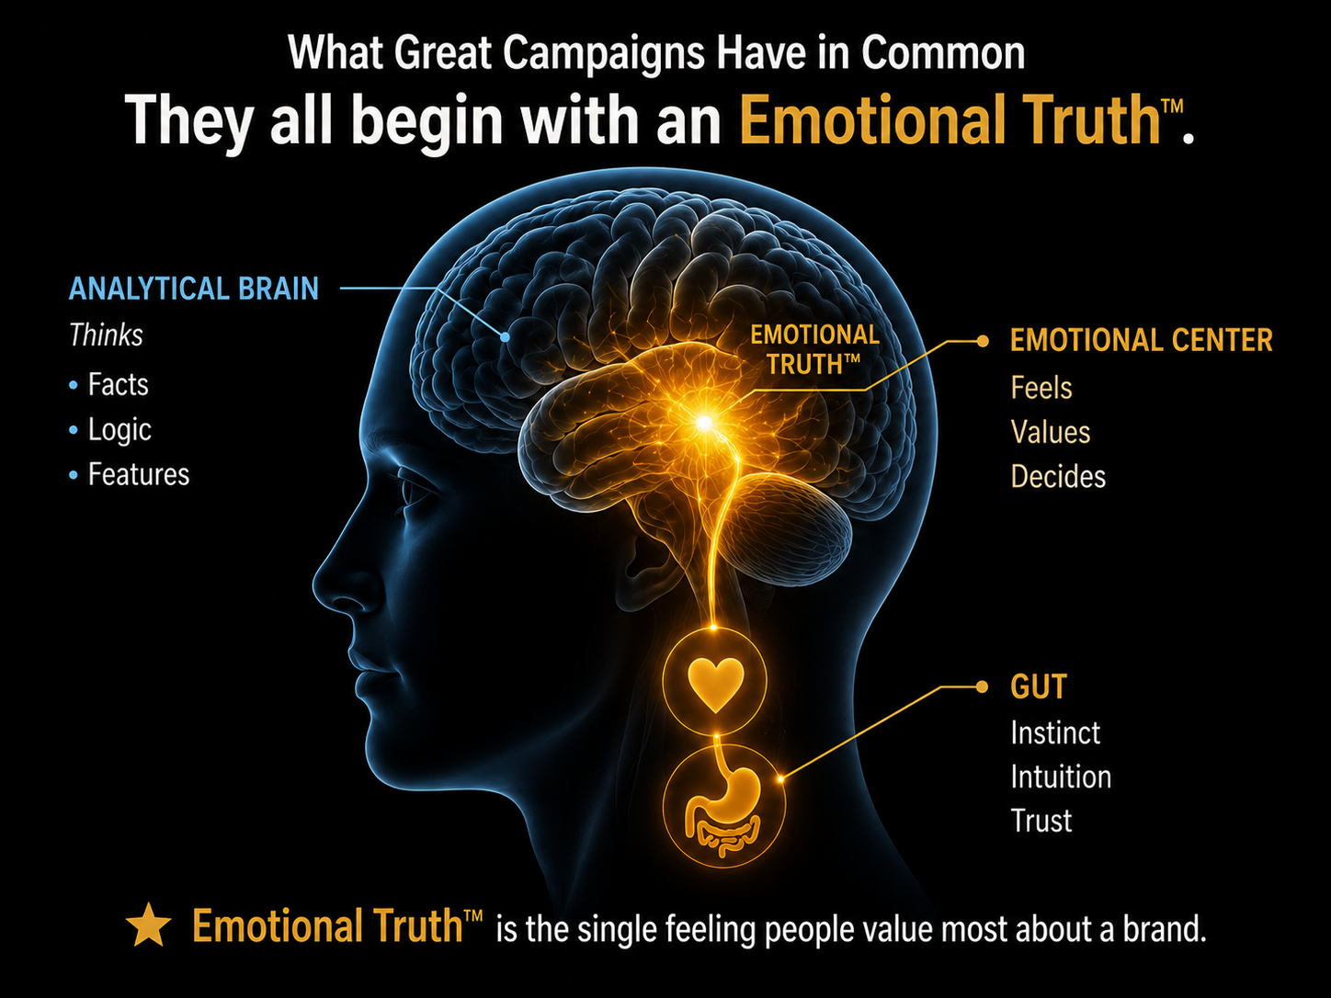


Slide 12

Emotional Truths™ are hidden between thousands of words within spontaneous buyer comments, emotions, stories and existing research.
And Emotional Truths™ are much more believable when connected to an Accepted Premise.

Slide 13
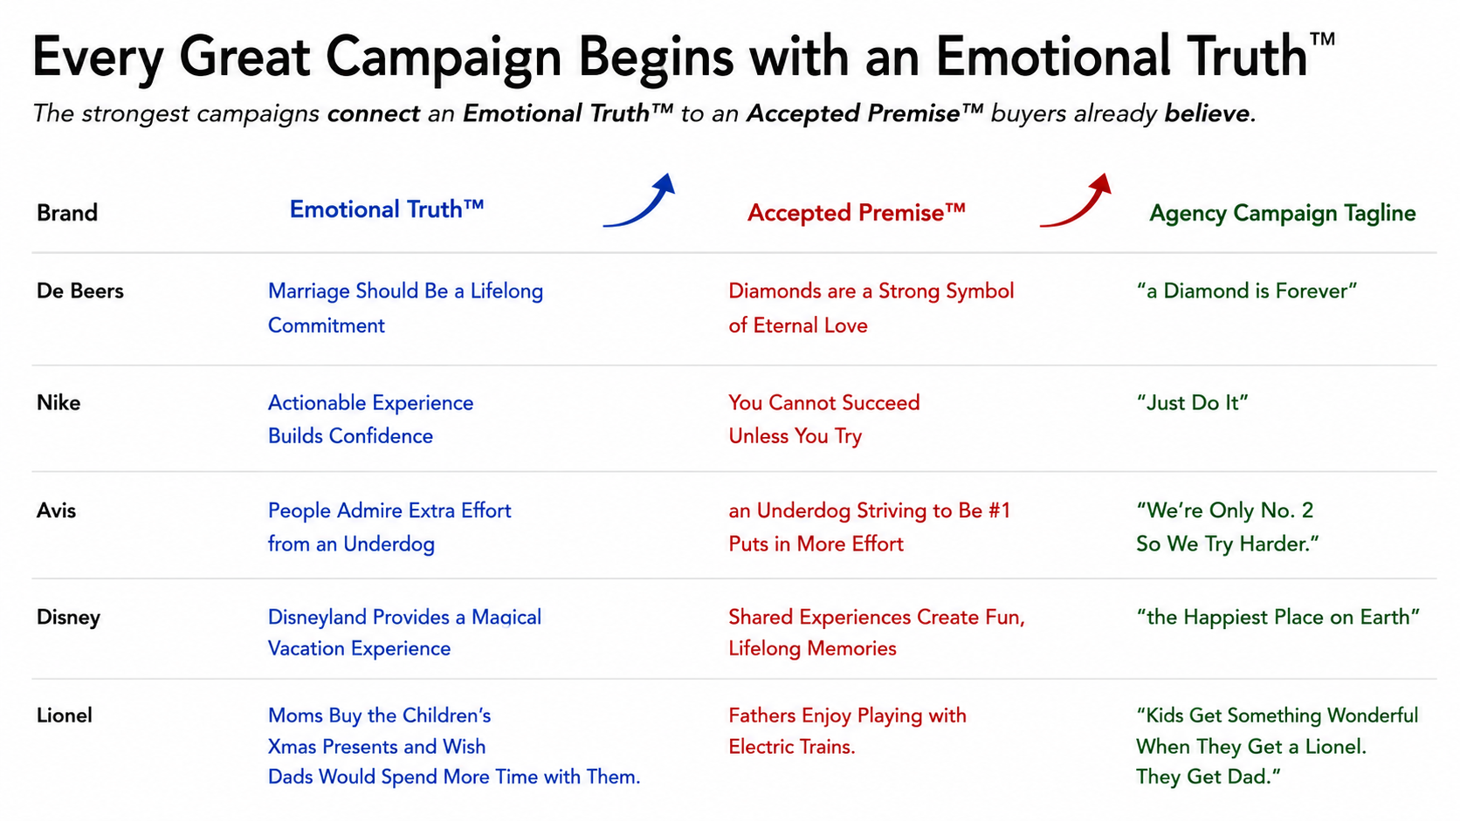
Notes:
Rev Eng 100 revealed same pattern: ET – AP – Agency Campaign Tagline. Notice the Flow. Every one starts with an Emotional Truth. That ET becomes believable because it Connects to an AP buyers already hold.Then agency creates memorable tagline.. :30 Nike didn’t invent confidence. They recognized that people gain confidence by taking action. They connected an ET to an AP we all believe expressed brilliantly with Just Do It. :45 Avis I actually worked on Avis at DDB. We accepted reality because people admire an underdog who tries harder. Once that AP clicked, We’re Only NO. 2. So we try harder almost wrote itself.

Slide 14
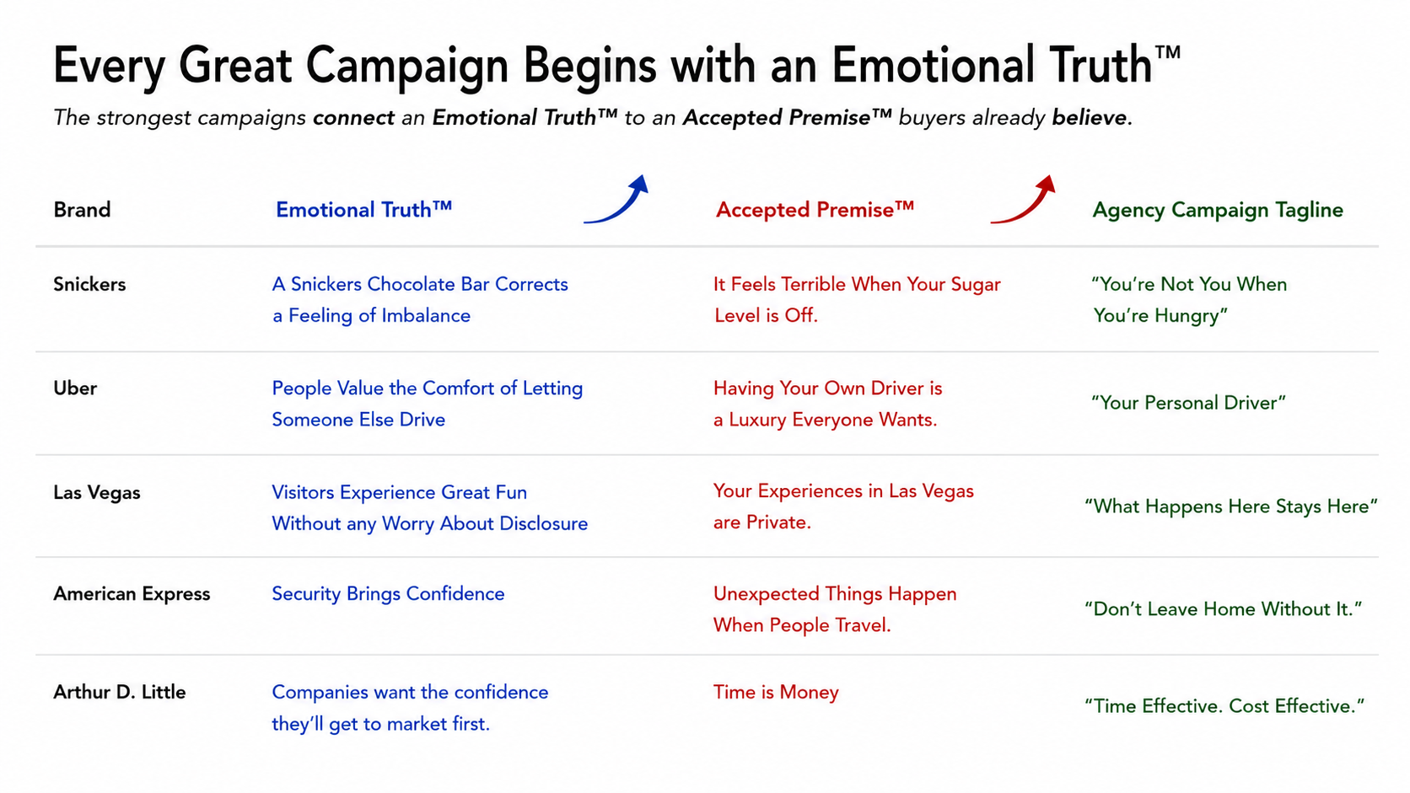
Notes:
What’s remarkable is that the same brand pattern shows up whether it’s a consumer brand of a B2B company. :60 Lionel I was fortunate to work on the Lionel team. Explain research MOM-Kids-Dad and Fathers Enjoy playing with electric trains. That became “Kids Get….the get dad.” It Helped save Lionel from bankruptcy. THE SAME PATTERN APPEARS AGAIN AND AGAIN. :60 ADL …Reputation for. Large, expensive and slow. Research revealed getting to market first was client goal. Positioned ADL Lean experienced teams and expressed it with Time Effective. Cost Effective. Landed 6 new accounts. In first 6 months. Hired us. Elsewhere. I won’t go through every example, but show this isn’t an isolated coincidence The same structure keeps appearing.

Slide 15
I first applied elements of this thinking at Arnold (HBM), helping win six new accounts and increase billings by more than 30% in the first year.
In my opinion these new Emotional Truth™ findings represent a major opportunity to pitch new clients, strengthen current ones and even strengthen your presentation.”
Imagine contacting a new business prospect and saying, “We've discovered something important about your customers that your current advertising isn't using.”
Notes:
No process can guarantee a legendary campaign. But every legendary campaign begins with a stronger strategic foundation than most.,
That's what Emotional Truth™ Discovery is designed to uncover.

Slide 16


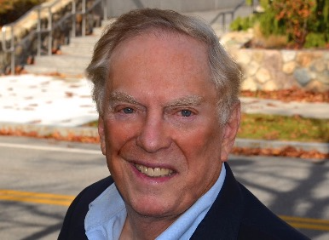
Help Your Agency Discover the Emotional Truth™
Behind Its Next Great Campaign.
For a quick opinion about a current client or new business opportunity, please contact us: 339-970-8773 kim@wallacewashburn.com

